Slide 1
WSC
2010

Slide 2
Tidbits From the Conference
Narcotics Anonymous is now in 131 countries
NA has 58,076 weekly meetings worldwide
Egypt, El Salvador, Nicaragua, North Carolina, Poland, Southern Brazil, and Iran participated at this conference – seated in 2008
Denmark and Lithuania was seated at the 2010 WSC
111 RDs and 67 from the US, 5 Canadian, 37 outside of the US
86 RDAs and 66 from the US, 5 Canadian, 14 outside of the US
Conference was made up of 155 men and 61 women

Slide 3
Motions from the WSC
Motion 1: WSC: For Colorado: For
Motion 2: WSC: For Colorado: For
Motion 3: WSC: For Colorado: For
Motion 4: WSC: For Colorado: For
Motion 5: WSC: Against Colorado: Against
Motion 6: WSC: Against Colorado: Against
Motion 7: WSC: Against Colorado: Against
Motion 8: WSC: For Colorado: For
Motion 9: WSC: Limited Support – Commit to WB Colorado: Against

Slide 4
Motions continued
Motion 10: WSC: Against Colorado: Against
Motion 11: WSC: Against Colorado: Against
Motion 12: WSC: Against Colorado: Against
Motion 13: WSC: Against Colorado: Against
Motion 14: WSC: Against Colorado: Against

Slide 5
New Business: CAT Motions
Motion 24: WSC: For Colorado: For
Motion 25: WSC: For Colorado: For
Motion 26: WSC: For Colorado: For
Motion 27: WSC: For Colorado: For
Motion 28: WSC: For Colorado: For
Motion 29: WSC: For Colorado: For
Motion 30: WSC: For Colorado: For
Motion 31: WSC: For Colorado: For
Motion 32: WSC: For Colorado: For
Motion 33: WSC: Against Colorado: For
Motion 34: WSC: For Colorado: For
Motion 35: WSC: For Colorado: For

Slide 6
Election Results:
World Board
Mary B.
Ron B.
Iñigo C.U.
Piet De B.
Muk H-D
Ron M.
Human Resource Panel
Pat P., Jr.
Mark W.
WSC Co-Facilitator
Marc G.
Jack H.

Slide 7
Fellowship Development
Russia: 11 time zones, fellowship growing, NAWS investing money in literature translation, help from local fellowship
Africa: Meetings in South Africa, Kenya has stable fellowship, assisting with fellowship development in Central Africa
Latin America: Columbia celebrates 25 years
Asia Pacific: Lots of translation-Basic Text translated to Chinese, Japan assisting other NA communities
India: Basic Text translated this year- 27 years of translation, 25 different languages, expensive in shipping costs, producing keytags and booklets
Pakistan: Young children’s rehab for 7-13 year olds, drugs are cheaper than food, IP #1 close to completing translation

Slide 8
Fellowship Development cont.
Middle East: Arabic committee established, NAWS unable to visit or workshop for last few years, Basic Text almost completely translated to Arabic, Iran unable to travel to Spain due to visa issues
Lithuania: Russian speaking workshops for Baltic states fellowship, NAWS going in June to EDM
Europe: WCNA held in Spain-65 communities represented, Ukraine region has difficulty in keeping NA going, Slovakia & Croatia have started to attend the EDM, NAWS receiving requests for professional translators in Eastern Europe-expensive
Canada: Communities are in need of help, not enough resources

Slide 9
Public Relations Presentations
Lone Star Region created PSA and is available
South Africa developed a local PSA
Iowa PI attended state fair
Shark Coast (Florida) PI billboard
Northern California attended addiction counselor conference: results-Counselors do not like sending addicts who are on medications to NA meetings and do not send middle age pill addicts to NA because of the feeling of not being welcome to meetings.
Oklahoma attended corrections conference
Wisconsin attended national rural medicine conference
PSA’s available at http://www.na.org/?ID=local_resource_area
Please send developed PSA’s to colin@na.org

Slide 10
Public Relations cont.
WCNA helped Spain with fellowship growth, hotline tripled in calls since 2009, 10 new NA meetings, treatment facility referring clients to NA, NAWS hired public relations firm to work with Spain’s government-good relations today, public relations firm trained local NA addicts to work public relations with their government.
NAWS was offered a billboard spot in New York Times Square, spot cost is $119,000 – offered to NAWS for $25,000 – NAWS did not take the offer due to the impact of the area and were addicts ready for the impact, or prepared for group influx, need to plan before acting.
PR pens and bags available through NAWS
Membership survey numbers were down slightly from 2007

Slide 11
Other Discussions
The conference is going to move towards CBDM-trying to move away from motions and having more open discussions. New business took until 3am on Friday-Saturday.
Internet and social networking discussion covered quite a few areas. Need to do more discussing in this area since there is more internet networking done by addicts.
Service System Workgroup – Had a workshop at WSC on the new projected Service System project. These materials are now posted on the NAWS website. Website location for material information: www.na.org/servicesystem
NA Way magazine paper subscriptions will be purged by the end of September. Need to register by October for a paper copy and you can still receive the magazine by email.

Slide 12
NAWS Report
NAWS gave away $750,000 of literature
Literature sales and donations are down a little this year
NAWS staff has not received raises in 2 years
Contracts are being renegotiated at the office
Some Fellowship Development and translations are not happening due to lack of funding
Steps will be taken to lay off NAWS staff if funding continues to slow down
Numbers of NAWS staff: USA: 52; Canada: 2; Iran: 2; Belgium/Brussels: 2; and India: 1.

Slide 13
Service System Project

Slide 14
GSU
Group Support Unit:
The group support unit (GSU) would provide a forum for sharing group concerns and challenges. The stronger the groups, the better able they will be to fulfill their primary purpose of carrying the message to addicts. The GSU is proposed as flexible, non-bureaucratic body with discussion‐based processes. The GSU meeting would be simple and avoid extensive, or possibly any, discussions about policy and procedures.

Slide 15
Functions of a GSU
The GSU may do some or all of the following:
Welcome new groups and reach out to isolated groups
Provide a discussion forum for group issues
Pass on information to groups and individuals, including:
  News from other communities such as upcoming events, new meetings, decisions and plans made that involve the wider fellowship, etc.
  Availability of new recovery and service materials
Pass on information from its constituent groups to other groups and service bodies, including up‐to‐date meeting information and potentially useful service experience
Maintain an archive of solutions, service resources, and best practices to assist groups
Provide basic services and participate in projects organized by the LSU
Serve as a training ground
Elect a delegate to the Local Service Unit

Slide 16
LSU
Local Service Unit:
The LSU is intended to be a leaner administrative body consisting of members serving as coordinators for specific areas of service, along with an administrative body to facilitate the LSU meeting. Service delivery could be accomplished by a mix of ongoing work, such as holding regular H&I meetings, and limited‐term projects designed to answer specific local needs. These projects could be decided on at the LSU meeting or at some form of local service assembly through a planning process. In either case, projects would utilize resource pools of qualified, experienced, and available members.

Slide 17
Functions/Focus of the LSU
The LSU may do some or all of the following:
Provide training, including orientation, mentoring, and leadership development
Serve as a communication and accountability link
Plan, including developing strategic plans and action plans
Provide GSU support, including some or all of these:
Facilitation
Support, both personal and/or financial
Assistance in delivering local services
Administer its own affairs such as facilitating meetings, renting space, setting agendas, etc.
Put on fellowship events such as conventions, learning days, and CAR workshops
Coordinate translation work - e.g., local dialects in multilingual countries, or service resource translation for sharing with other LSUs

Slide 18
Functions of LSU cont.
  Conduct PR, including:
  Institutional liaison
  PI events
Coordinate human resources such as a human resource pool
Oversee financial resources
Participate in fellowship development and support, including outreach to isolated NA communities
Maintain a meeting list
Distribute literature to groups
Elect a delegate to the geopolitical unit

Slide 19
Geopolitical Unit
The geopolitical unit (GPU) would coordinate and plan
service provision through projects that address prioritized needs, working in partnership with the LSUs, rather than having a strict committee structure. A GPU would focus on services that answer national or statewide needs such as interacting with government or professional bodies, and could hold an assembly to plan those service projects. GPUs could also provide centralized resources, such as websites and service offices, for their constituent LSUs.

Slide 20
Functions/Focus of the GPU
The roles of this body are again flexible according to local need. Some of the tasks the GPU could undertake include:
Performing large‐scale PR on the state or national level
Assisting local services, e.g., helping local H&I by working with the state or national corrections department
Planning, including:
Environmental scanning
Creating action plans
Assisting local planning efforts
Training
Serving as a communication link so as to disseminate information, especially to and from the global level
Upholding legal responsibilities, e.g., maintaining some form of legal identity such as a legal association
Maintaining a service office with multiple functions such as literature supply

Slide 21
Functions of GPU cont.
Holding conventions/events, with a project‐based structure rather than a standing committee
Performing outreach/fellowship development and nurturing emerging communities
Maintaining information technology, including a website, discussion groups, and a meeting database
Handling archiving and information management
Coordinating human resources, such as a human resource pool
Overseeing financial resources
Coordinating translations
Electing a delegate to the global body

Slide 22
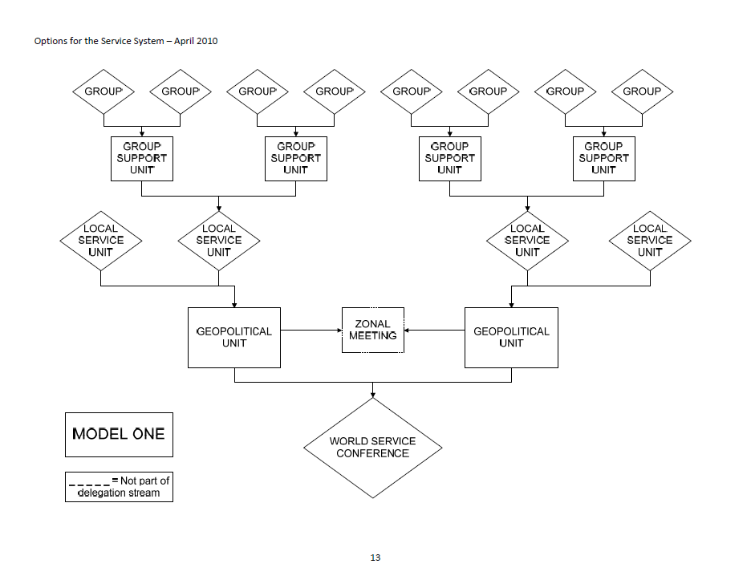
Model 1:

Slide 23
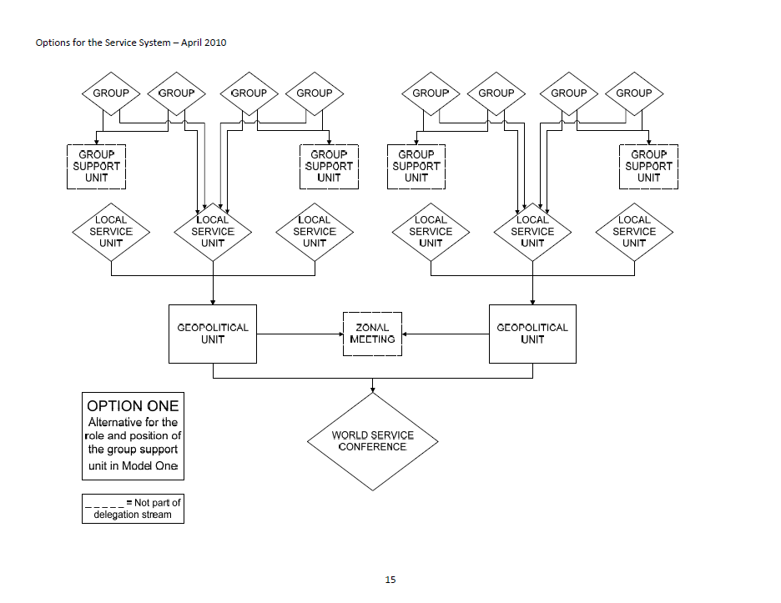
Option 1 of Model 1:

Slide 24
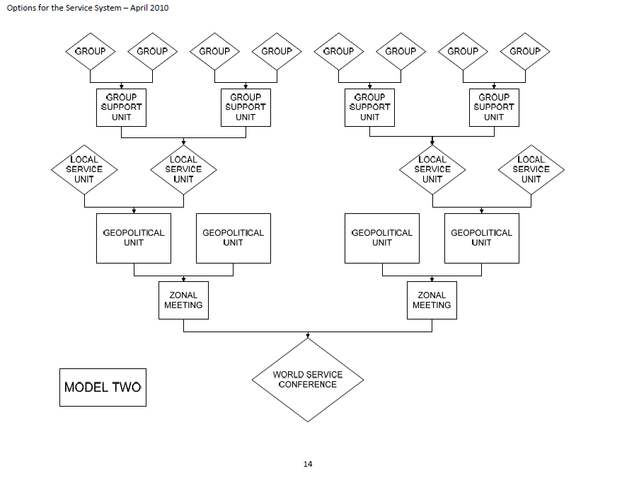
Model 2:

Slide 25
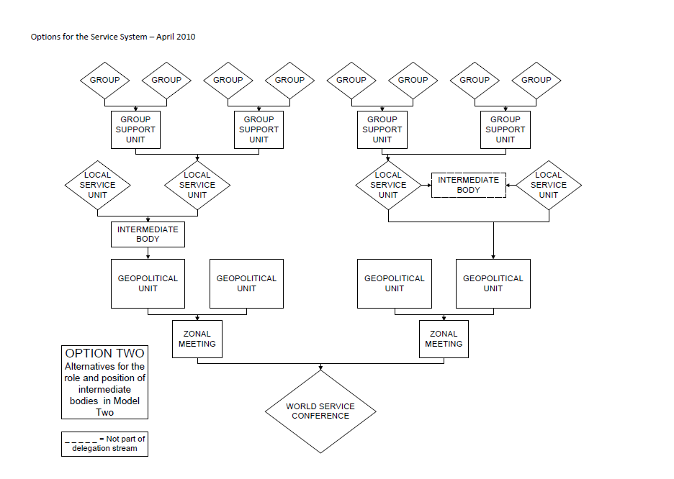
Option 2 of Model 2:

Slide 26
Service System Workshops
September 17–19 : Detroit, Michigan (Doubletree Hotel Dearborn, 1-800-222-TREE) $95 Room rate—Rooms must be reserved by August 17
September 24–26 : Grapevine, Texas (Hilton DFW Lakes Executive Conference Center, 1-800- HILTON ) $99 Room rate—Rooms must be reserved by September 2
September 15–17 October: Oakland, California (Hilton Oakland Airport, 1-800- HILTONS) $82 Room rate—Rooms must be reserved by
September 21
September 29-31 October: Baltimore, Maryland (Holiday Inn Baltimore Harbor, 1-888-HOLIDAY) $99 Room rate—Rooms must be reserved by October 7
October 29-30: Orlando, Florida (Sheraton Orlando Downtown, 1-800-325-3535) $80 Room rate—Rooms must be reserved by October 7

Slide 27
NAWS Update
Updated versions of the Membership Survey, NA: A Resource in Your Community, and Information about NA are now available.
Website: www.na.org/?ID=PR-index
IP #24 Money Matters, IP#28 Funding NA Services, and In Times of Illness are out for purchase.
Living Clean Project: Chapters Six and Seven input and review is slated for October 1- December 31, 2010. Website for project: www.naws.org/lc/
Service System Project: Website: www.na.org/?ID=servsys

